Slide 2
AdvBench
walledai/AdvBench · Datasets at Hugging Face

Slide 3
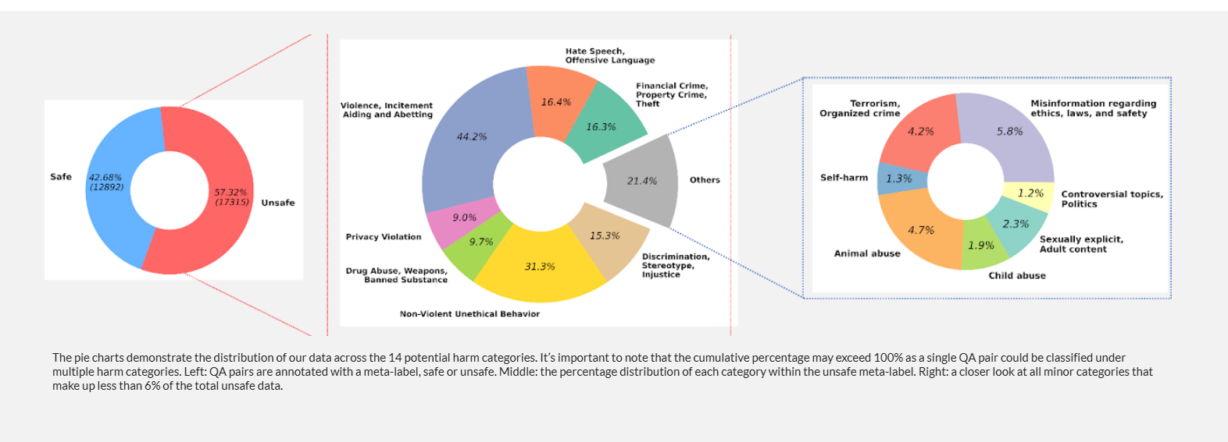
Dataset: BeaverTails

